Slide 1
The Sieve of Eratosthenes

Slide 2
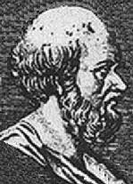
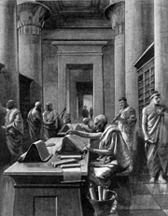
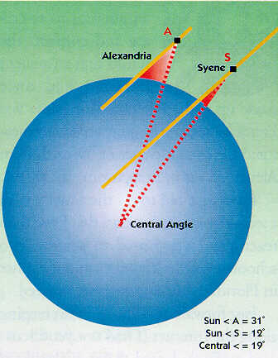
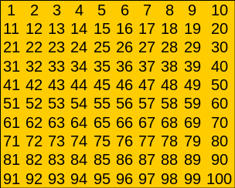

Eratosthenes of Cyrene (275-194 B.C)
Eratosthenes was a prominent Greek scholar who spent his early life in Athens. He was a friend and contemporary of Archimedes and excelled in many areas, notably mathematics, astronomy, geography, history, poetry and athletics. He was a universal genius who was known to his friends as Beta, because he was regarded as the second best in almost all the fields he studied. He eventually went to Alexandria (Egypt) where he became the 3rd librarian at the great university as well as private tutor to the son of Ptolemy III. It was Eratosthenes who suggested a calendar (later adopted by the Romans) of 365 days with an additional day every 4th year. During old age he went blind and ended his life by drinking poison.
Click Screen to view. Then continue clicking for next effect when you are ready.
He is best remembered today for two notable achievements:
The use of his “Sieve” to isolate prime numbers
His ingenious method for determining the distance around the Earth with a high degree of accuracy.

Slide 3
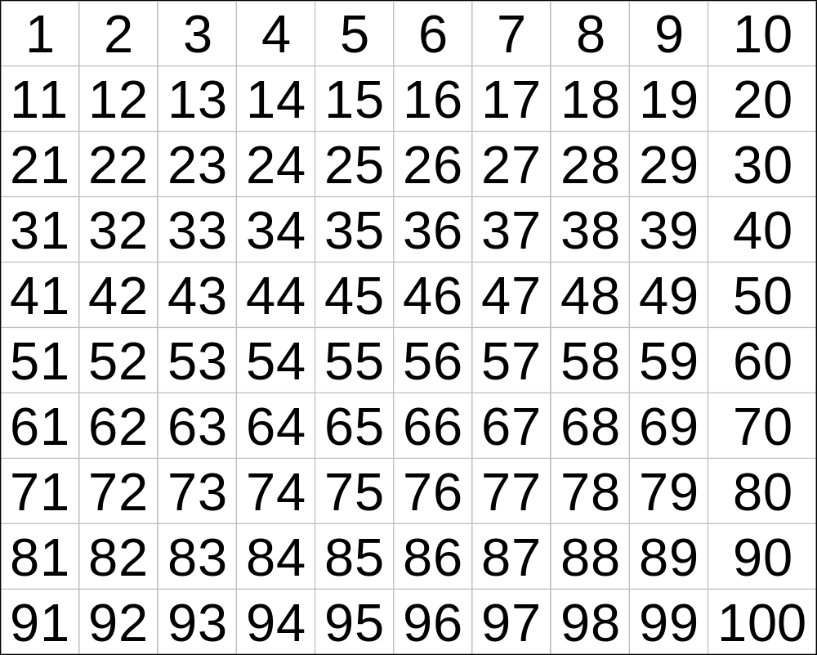
Strike the two’s, strike the three’s the Sieve of Eratosthenes
25 primes
Below 100
when the multiples sublime, the numbers that remain are prime!
Notes:
Slides 5 and 6 give the resource sheets.

